Slide 1
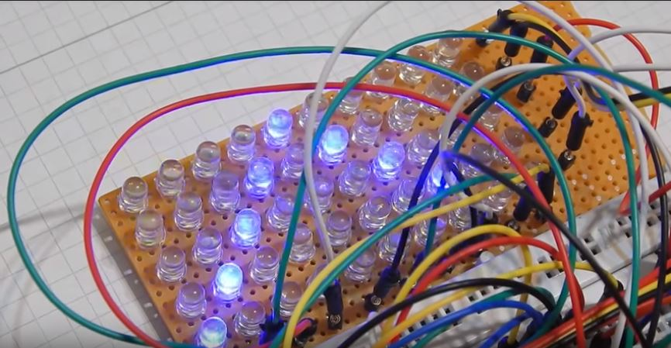
Programmable LED Matrix

Slide 2
Our Vision
To develop a 8 by 15 programmable LED grid that displays useful information.
Users can control this grid via their cell phone to display colorful animations and text to the screen.

Slide 3
Project Organization
Nicholas Garcia - Project Architect / Technical Lead
Devon Marantz - Systems Integration Test Engineer
Kenny Leon - Chief Software Lead
Abraham Nkum - Software Simulation Test Engineer
Harrison - Quality Assurance / Compliance Officer
Tunji Owolabi - Project Manager

Slide 4
Project Organization - Our Process So Far
Project Decision
Work Breakdown
Cost Analysis
Reviewing
We decided that we were going to do a 5x5x5 LED Cube
We started to break down the work and try
We figured out all of the parts that we would need for our project.
We decided that our design would be too costly.

Slide 5
Project Organization - Our Revised Decision
Project Decision
Work Breakdown
Cost Analysis
Reviewing
We decided that we were going to do a 8x15 LED Matrix
We started to break down the work and try
We figured out all of the parts that we would need for our project.
We tried to decide how we can execute and improve on our design.

Slide 6
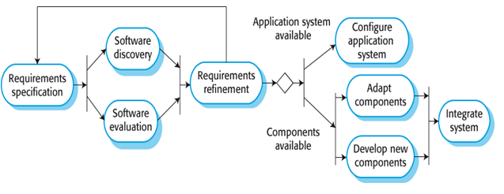
Integration and Configuration

Slide 7
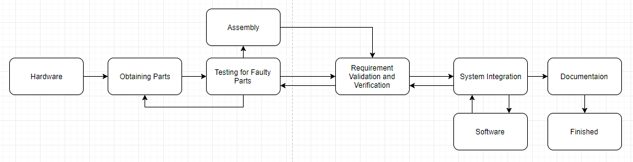

Slide 8
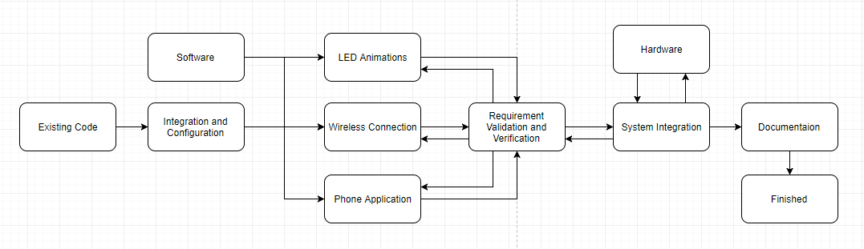

Slide 9
Work Breakdown
Hardware Obtaining Parts Abe Assembly (Soldering) Devon Assembly (Circuit) Nick Faulty Parts Check Devon & Nick Validation & Verification Devon, Nick, & Tunji
Software Definitions & Animations Abe & Harrison I/O Specification Abe & Harrison Arduino Application Abe, Harrison, & Kenny Phone Application Kenny Validation & Verification Abe, Harrison, Kenny, & Tunji
System System Integration Everyone Documentation Tunji

Slide 10
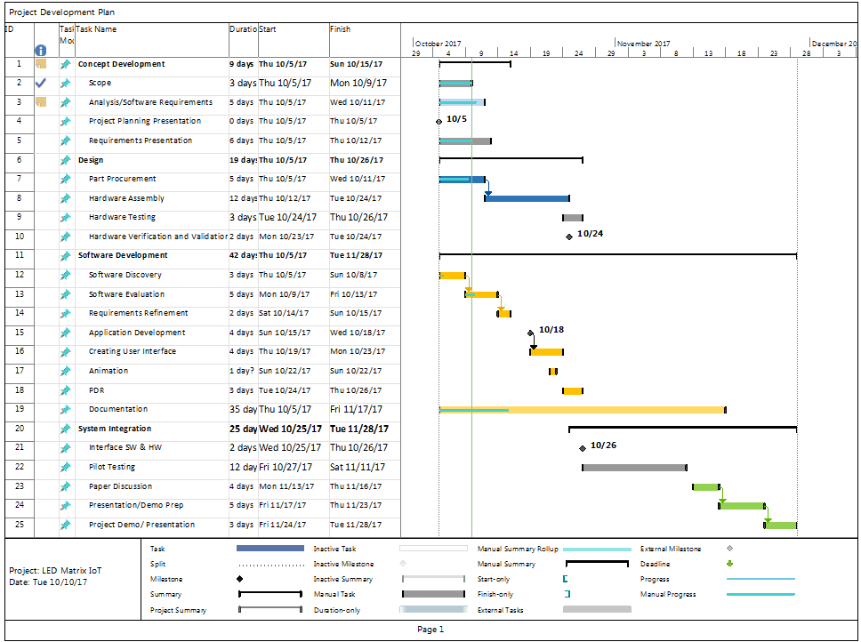
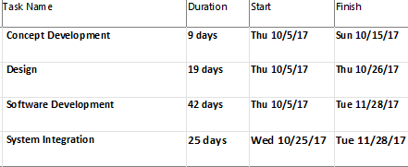
Timeline

Slide 11
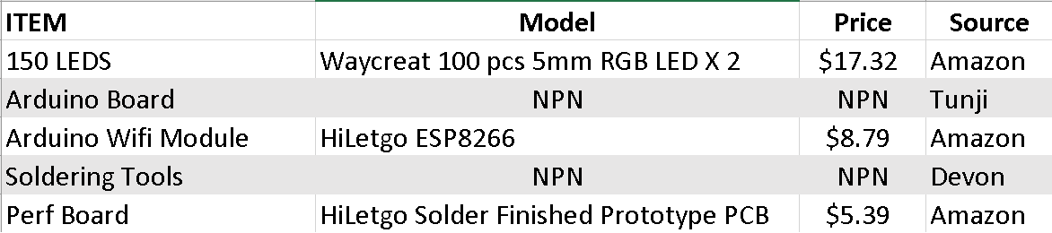
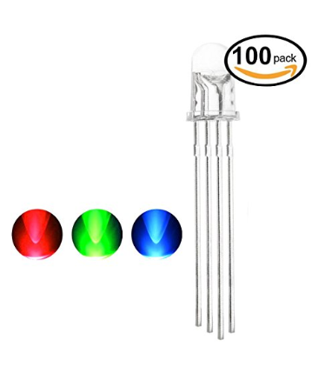
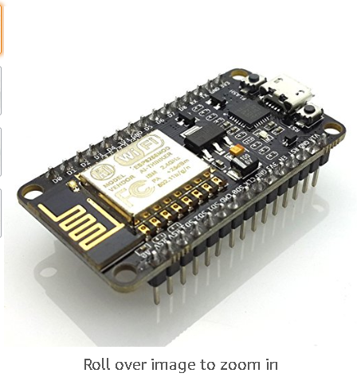
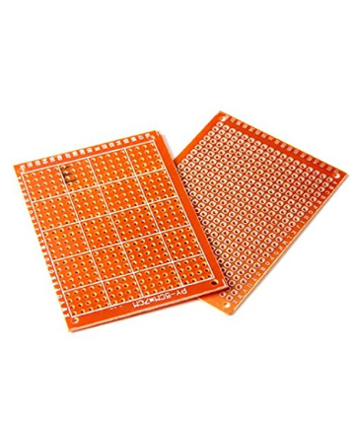
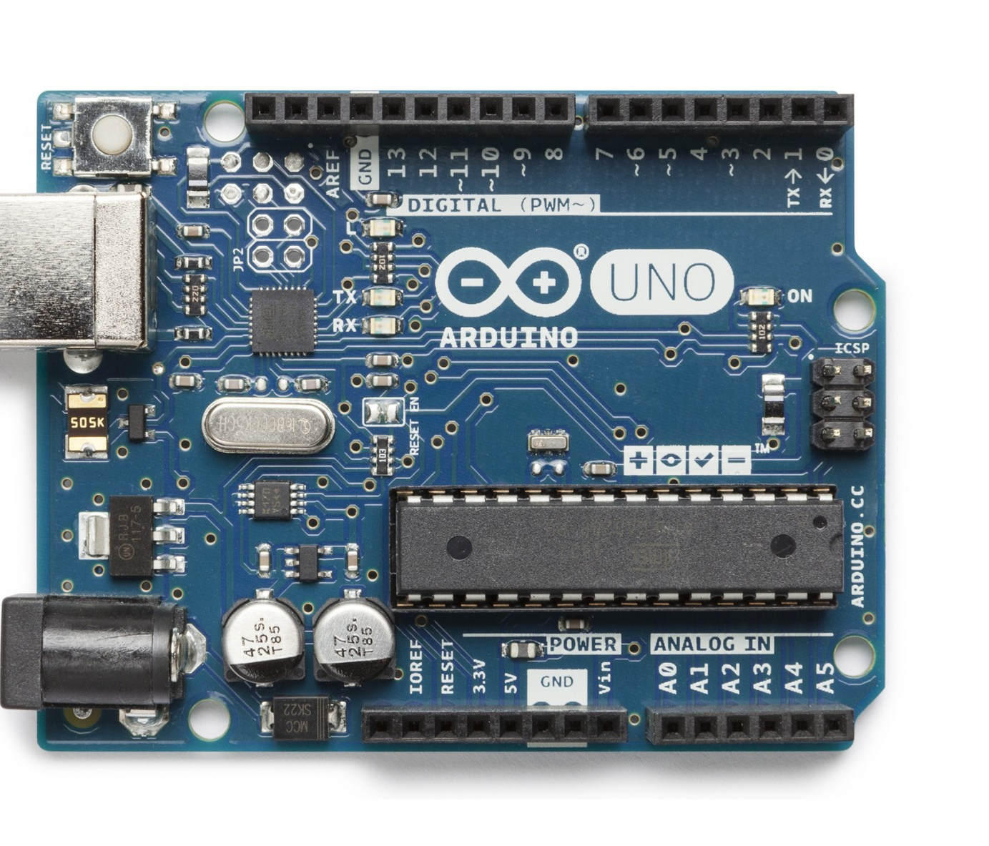
Pricing
Abraham
Individual contribution: (17.32+8.79+$5.39)/ 6= $5.25
*NPN- No Purchase Necessary

Slide 12
Risk Analysis
Risk: Probability: Effects:
Delay on hardware delivery Moderate Serious
Delay on hardware assembly Moderate Tolerable
Faulty hardware being received Low Serious
Oversights on project Moderate Serious
Interfacing problems High Tolerable
Software integration problems Moderate Serious
Software design issues Moderate Serious
Time Restraints on participants High Tolerable

